Slide 1
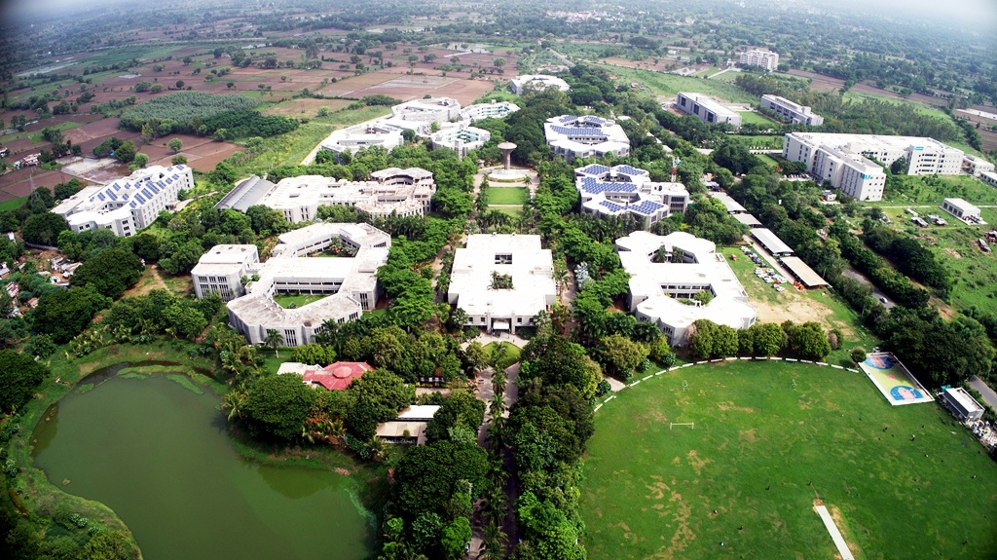


Memory Allocation & Memory Management
Ms. Trusha Patel
Assistant Professor
https://sites.google.com/view/mrstrusha

Slide 2
Subroutine
Procedure
Macro
Function

Slide 3
Main
IS
Procedure
CALL
Procedure
CALL
Procedure
CALL

Slide 4
Execution
of
procedure
Activation
of
procedure
Activation Record
Refer
Return value
Actual parameters
For each activation
Control link
Access link
Saved machine status
Activation
Record
Local data
Temporaries

Slide 5
Activation Tree
Depict the way control enters and leaves activation
Control Stack
Keep track of live procedure activation

Slide 6
MAIN
P1
MAIN
.
.
.
P1
.
.
.
P4
.
.
.
.
.
P2
.
P2
P1
P4
.
.
P3
.
Activation record of P3
Activation record of P4
Activation record of P2
P3
Activation record of P4
P2
P4
.
.
.
Activation record of P1
Activation record of P4
P4
P3
P4
.
P4
.
Activation record of MAIN
Control Stack
Activation Tree

Slide 7
Environment
Name
Storage
Value
State

Slide 8
Storage of
all data
at
Compile
time
Allocate &
deallocate
storage as
needed
at
run time
Stack
Allocation
Static
Allocation
Heap
Allocation
Manage
run time
storage
as
stack

Slide 9
Names are bound to storage at the time of compilation of program
No need of run time support package
Static
Allocation
Binding do not change at run time
Every time a procedure is activated, names are bound to same storage
Value of local names retained across activation of procedure

Slide 10
Size of data object must be known at compile time
Static
Allocation
Recursive procedures are restricted, as all activations use the same binding
Data structures cannot be created dynamically

Slide 11
Storage is organized as stack
Activation records are pushed and popped as activation begin and end
Stack
Allocation
Locals are bound to fresh storage in each activation
Values of locals are deleted when the activation ends
Size of data object must be known at compile time

Slide 12
Allocation and deallocation of storage at run time
Heap
Allocation
Some time and space overhead associated with heap manager
Not required to know the size of data object at compile time

Slide 13
Code
Static data
Stack
Heap

Slide 14
Reference
Alfred Aho, Ravi Sethi, Jeffrey D Ullman, Compilers Principles, Techniques and Tools, Pearson Education Asia.

